Slide 1
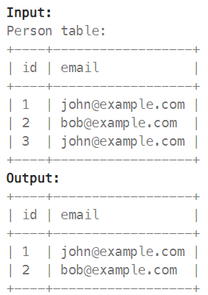
Q1. Write a Solution to delete all duplicate emails, keeping only one unique email
Code:
Result:

Slide 2
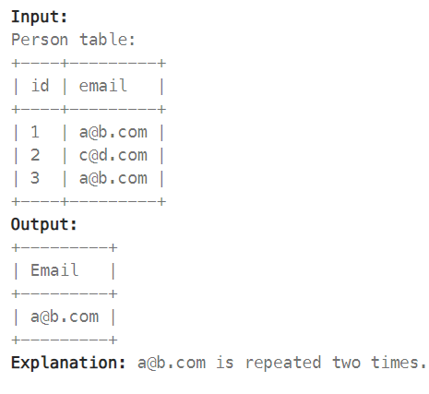
Q2. Write a solution to report all the duplicate emails. Note that it's guaranteed that the email field is not NULL.
Code:
Result:

Slide 3
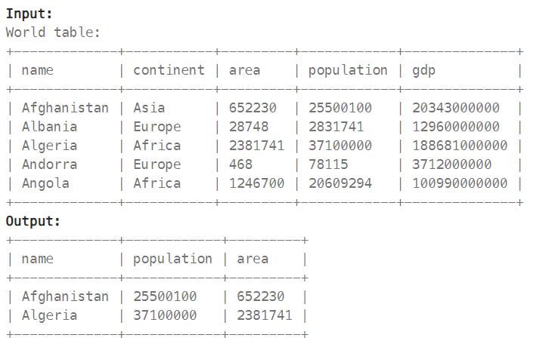
Q3. A country is big if: it has an area of at least three million (i.e, 3000000 km2), or it has a population of at least twenty-five million 25000000
Write a solution to find the name, population, and area of the big countries.
Code:
Result:

Slide 4
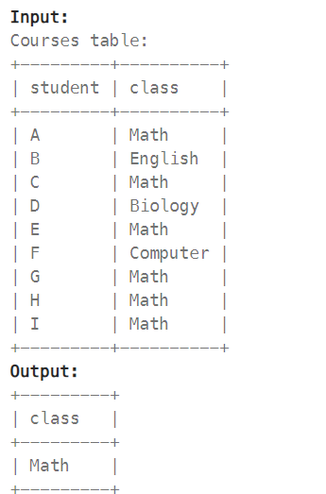
Q4. Write a solution to find all the classes that have at least five students.
Code:
Result:

Slide 5
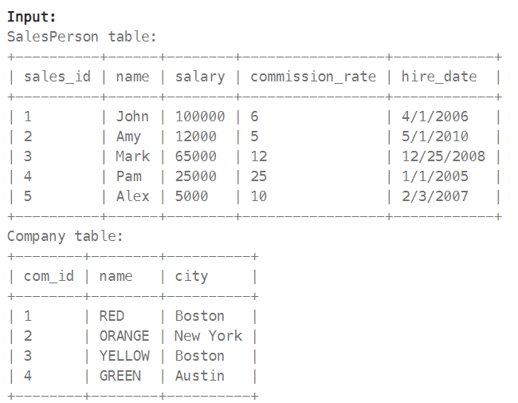
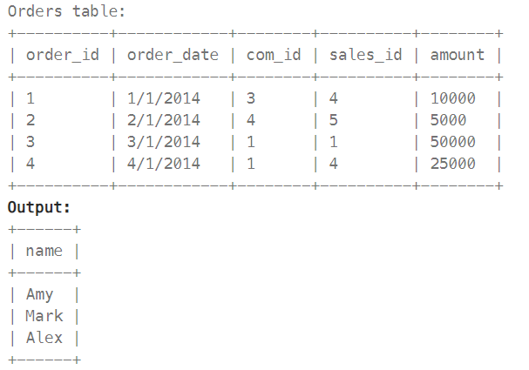
Q5. Write a solution to find the names of all the salespersons who did not have any orders related to the company with the name "RED"
Code:
Result:

Slide 6
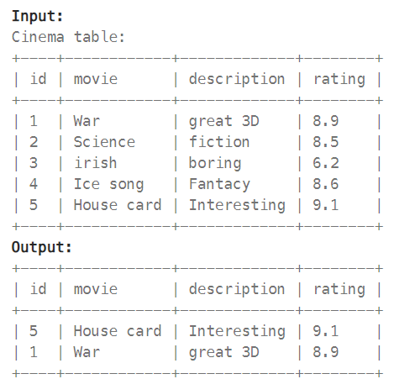
Q6. Write a solution to report the movies with an odd-numbered ID and a description that is not “boring” Return the result table ordered by rating in desc order
Code:
Result:

Slide 7
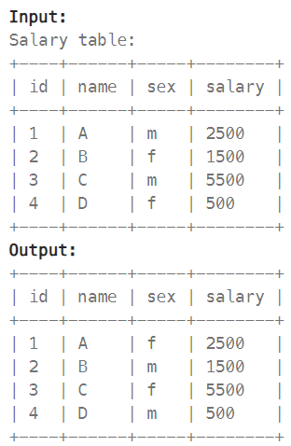
Q7. Write a solution to swap all ’f’ and ‘m’ values (i.e., change all ‘f’ values to ‘m’ and vice versa)
Code:
Result:

Slide 8
Q8. Write a solution to swap all ’f’ and ‘m’ values (i.e., change all ‘f’ values to ‘m’ and vice versa)
Code:
Result:

Slide 9
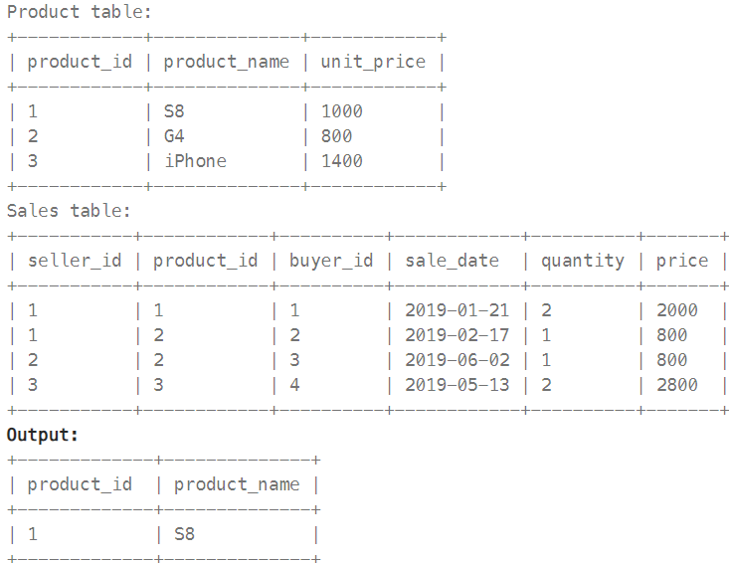
Q9. Write a solution to report the products that were only sold in the first quarter of 2019. That is between 2019-01-01 and 2019-03-31 inclusive.
Code:
Result:

Slide 10
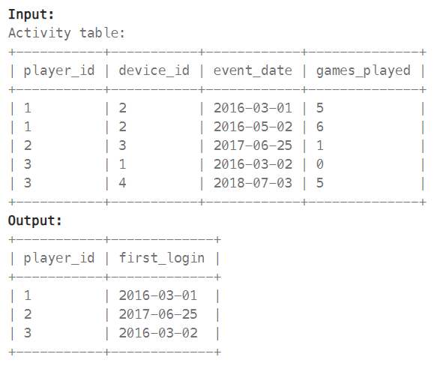
Q10. Write a solution to find the first login date for each player.
Code:
Result:

